Slide 1
Sound Intensity

Slide 2
Sound Intensity
Previously, we defined waves as “travelling disturbances that transport energy from one location to another without transporting matter”.
We can define the power of a wave as the rate at which this energy is emitted by its source (measured in watts).
However, as a wave travels away from its source, its energy spreads over a larger area (measured in m² for a 3D wave).
Together, these factors determine the intensity of a wave.

Slide 3
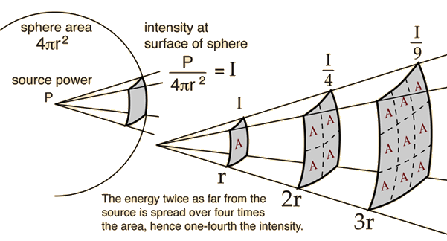
Sound Intensity
The intensity of a wave (I) is defined as:
$$I=\frac{P}{A}$$
where P is the power carried by the wave and A is the area over which the wave is acting. It is measured in watts per square meter (W m⁻²).
In many cases (e.g. sound, seismic waves), a wave source can be thought of as a point from which waves spread out in a spherical pattern. Accordingly, the area over which the wave is acting is equal to the surface area of a sphere:
$$A=4πr^{2}$$
where r is the distance from the source.

Slide 4
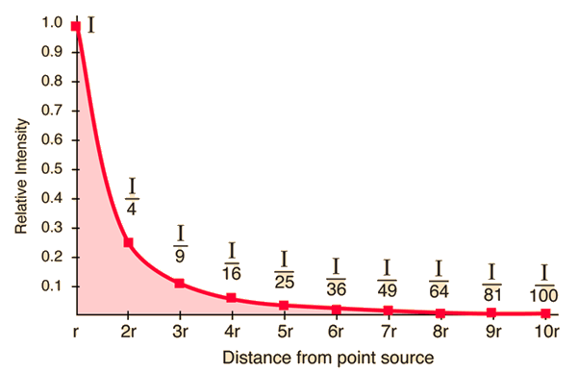
Sound Intensity
So far, we have:
$$I=\frac{P}{4πr^{2}}$$
Assuming that P is constant, the only remaining variable is r, so intensity is said to be proportional to 1/r²:
$$I∝\frac{1}{r^{2}}$$
This relationship between intensity and distance is an example of an inverse square law. (Gravity and electrostatic force are also calculated using inverse square laws.)
Notes:
P can be assumed to be constant for the same wave, waves from a source of constant power, or even waves from a source of constant average power over a period of time.

Slide 5
Sound Intensity
Though it is difficult to measure and calculate intensity, it is easy to compare the intensity of the same wave (or waves from a source of constant power) at two different distances. Consider:
$$I_{1}=\frac{P_{1}}{4π{r_{1}}^{2}} \text{and} I_{2}=\frac{P_{2}}{4π{r_{2}}^{2}}$$
$$\text{So} P_{1}=4π{r_{1}}^{2}I_{1} \text{and} P_{2}=4π{r_{2}}^{2}I_{2}$$
For the same wave or constant wave source, P₁ = P₂, so:
$$4π{r_{1}}^{2}I_{1}=4π{r_{2}}^{2}I_{2}$$
$$\frac{I_{1}}{I_{2}}=\frac{{r_{2}}^{2}}{{r_{1}}^{2}}$$
Notes:
Calculating intensity directly is a complicated process that is well beyond the scope of this course. If you don’t believe me, check out https://pressbooks.online.ucf.edu/osuniversityphysics/chapter/17-3-sound-intensity/ - but don’t say I didn’t warn you!

Slide 6
Sound Intensity
Or, from the proportionality relationship:
$$I∝\frac{1}{r^{2}}$$
$$\frac{I_{1}}{I_{2}}=\frac{\left(\frac{1}{{r_{1}}^{2}}\right)}{\left(\frac{1}{{r_{2}}^{2}}\right)}$$
$$\frac{I_{1}}{I_{2}}=\frac{{r_{2}}^{2}}{{r_{1}}^{2}}$$
Notes:
This is how the textbook does it, and it uses the formula that the formula sheet provides, but simply saying “Since the proportionality constants are the same…” then jumping straight to the big fraction is definitely a hand-waving explanation.

Slide 7
Example #1
Gemma is at an outdoor concert and is 25.0 m from the stage. She decides to measure the sound intensity and finds that it is 5.00 × 10⁻⁴ W m⁻². She sees some friends who are 15.5 m from the stage and decides to join them. Calculate the expected sound intensity at this new location.
$$I∝\frac{1}{r^{2}}$$
$$\frac{I_{1}}{I_{2}}=\frac{{r_{2}}^{2}}{{r_{1}}^{2}}$$
Let I₁ be the sound intensity at the new location:
$$I_{1}=I_{2}\frac{{r_{2}}^{2}}{{r_{1}}^{2}}=\left(5×{10}^{−4}\right)\frac{{25}^{2}}{{15.5}^{2}}=1.30×{10}^{−3} \text{W} {\text{m}}^{−2}$$
Notes:
This assumes that the band keeps playing at the same average volume.
Sanity check: she’s closer, so we expect a higher intensity.

Slide 8
Example #2
Sam heard an annoying sound from 100 m away. By what factor would the intensity of the annoying sound change if Sam was to move to a distance of 400 m from the sound?
$$I∝\frac{1}{r^{2}}$$
$$\frac{I_{400}}{I_{100}}=\frac{{r_{100}}^{2}}{{r_{400}}^{2}}$$
$$\frac{I_{400}}{I_{100}}=\frac{{100}^{2}}{{400}^{2}}=\frac{1}{16}=0.0625$$
The intensity of the sound at 400 m would be 0.0625 times (1/16th of) its intensity at 100 m.

Slide 9
Example #3
The threshold of pain for human hearing occurs when sound is at an intensity of 10.0 W m⁻². A jet engine produces a sound intensity of 562 W m⁻² at a distance of 2.00 m from the engine. Calculate how far you would need to be from a jet engine for the intensity of its sound to drop below the threshold of pain.
Notes:
15.0 m. This seems smaller than we might expect, but consider the graph on slide 4 and it looks a lot more reasonable.

Slide 10
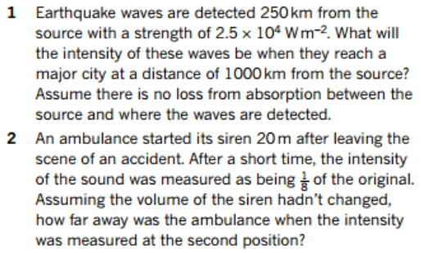
Textbook Questions

